Slide 1
MODEL TRAIN CONTROLLER

Slide 2
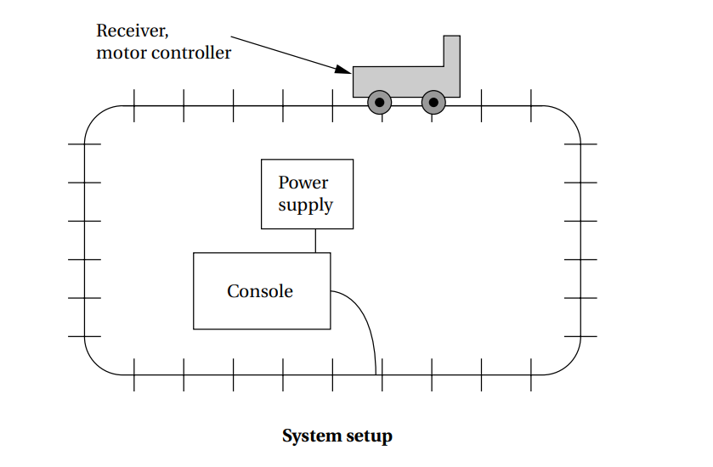
System setup

Slide 3
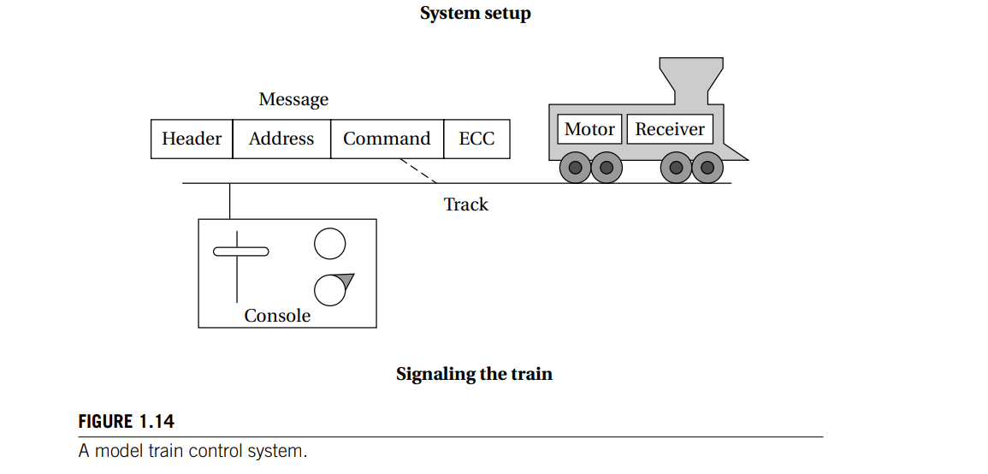
Signaling

Slide 4
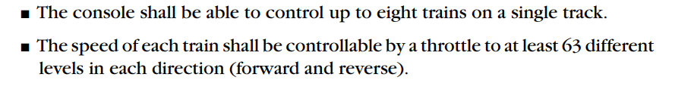
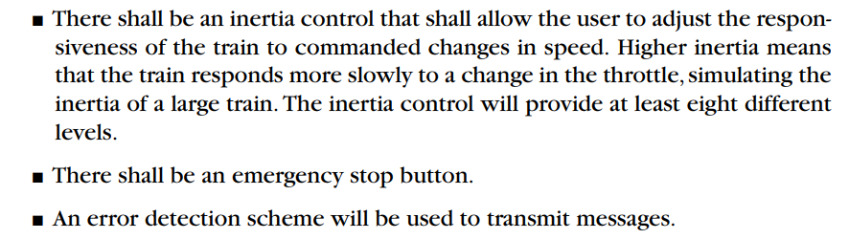
Requirements

Slide 5
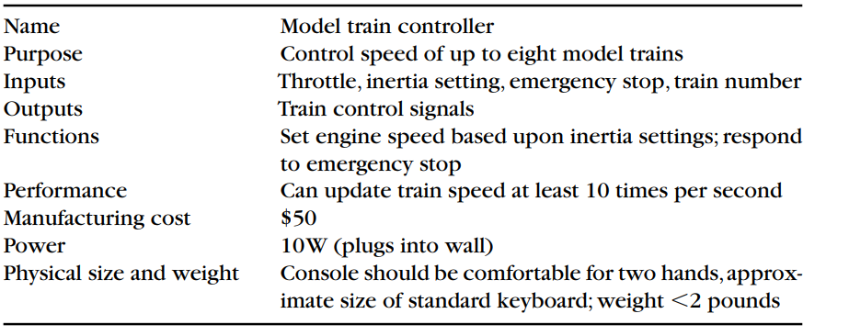
Requirement form

Slide 6
Digital Command Control (DCC)
DCC was created to provide a standard that could be built by any manufacturer so that hobbyists could mix and match components from multiple vendors.
The DCC standard is given in two documents:
■ Standard S-9.1, the DCC Electrical Standard, defines how bits are encoded on the rails for transmission.
■ Standard S-9.2, the DCC Communication Standard, defines the packets that carry information.

Slide 7
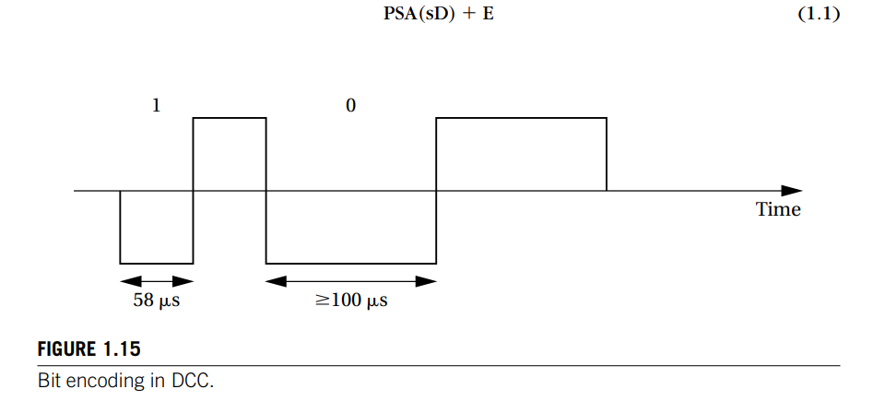
Bit encoding

Slide 8
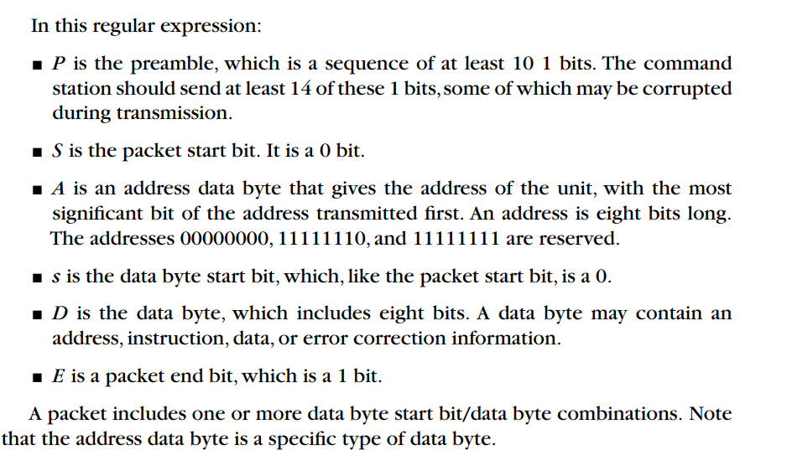

Slide 9
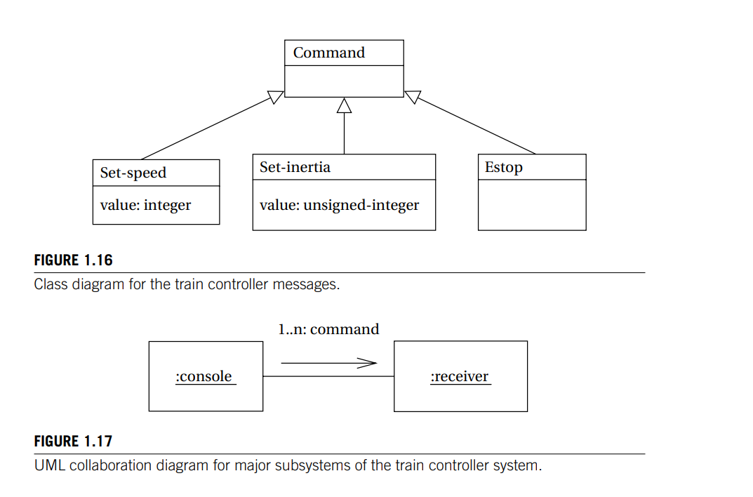

Slide 10
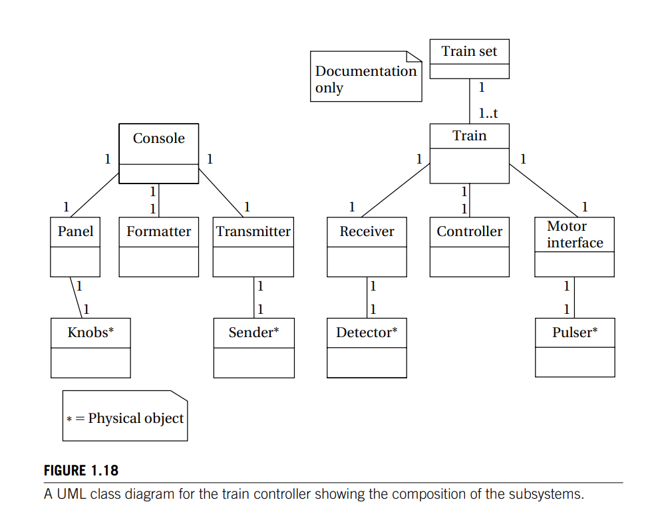

Slide 11
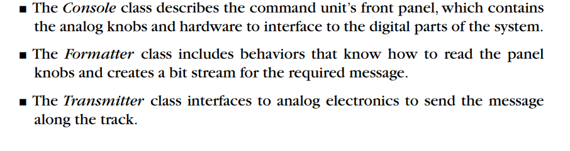
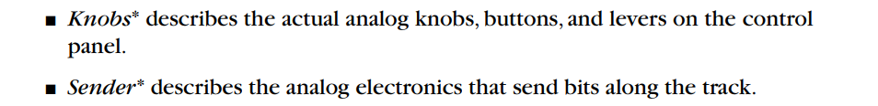
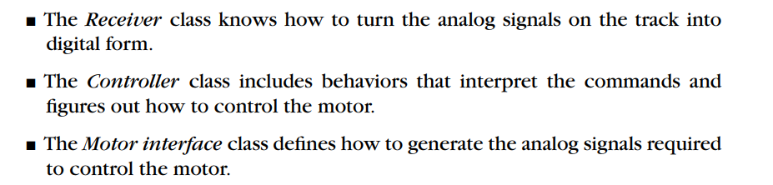
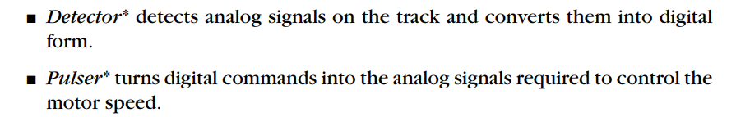

Slide 12
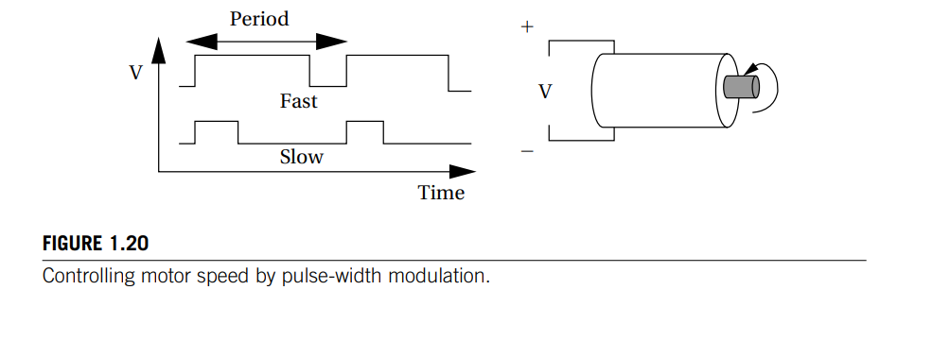
Motor speed control

Slide 13
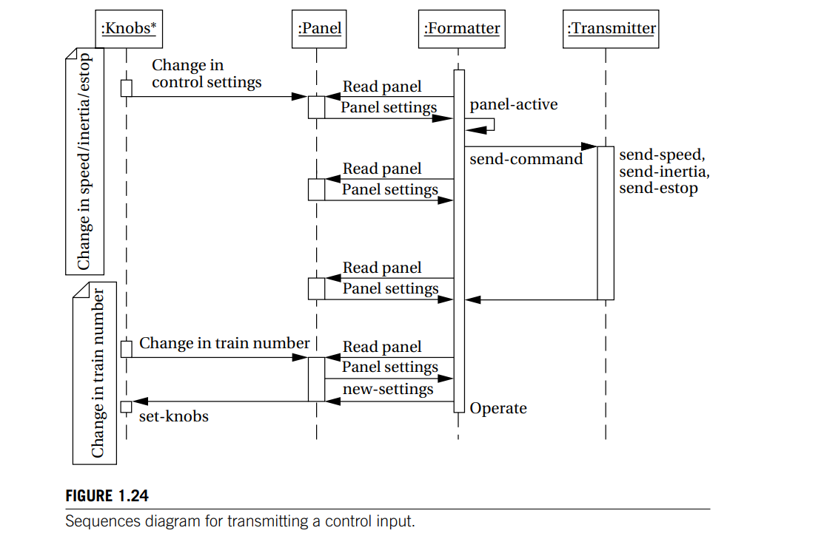
Sequence Diagram

